Slide 1
Capstone ai & machine learning developer project 3: rick chua kee siong
developing AI/ML model:
Sales predictive forecast accuracy model for deployment

Slide 2


Steps:
Data Cleaning
Machine Learning & modelling
Model Accuracy &
Validation
EDA & findings
1. Data Prep
Lessons
learned
Summary
And future work
Model Selection
Model
Deployment
Data Source
References

Slide 3
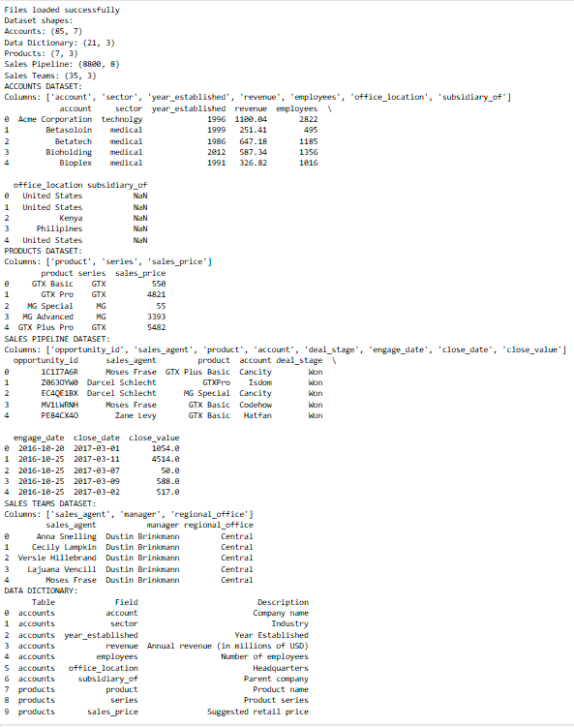
Data Preparation Inspection
Code Snippets
Load dataset and inspection

Slide 4
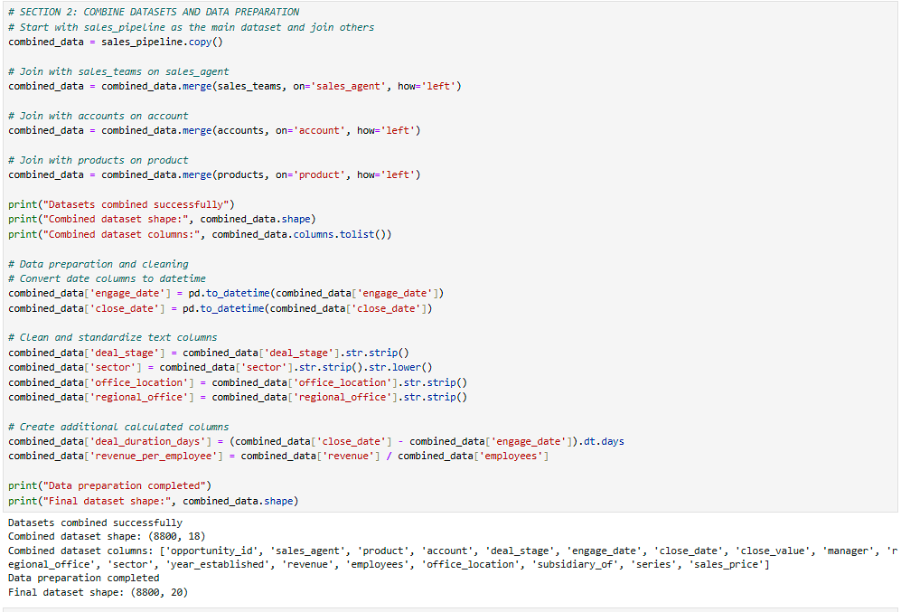
Data Preparation Inspection
Code Snippets
Combined dataset
Print data shape:
(8800 rows, 20 columns)

Slide 5
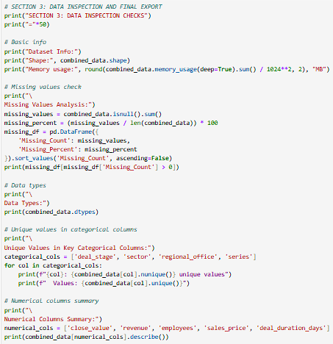
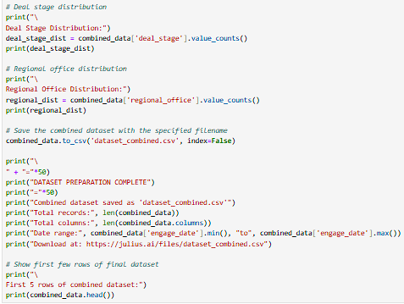
Data cleaning
Code Snippets
Key Improvements Made:
Filled missing subsidiary_of values with 'Independent'
Standardized all text fields (proper case, consistent formatting)
Fixed sector typo ('technolgy' → 'technology')
Converted categorical columns to category type for memory efficiency
Handled extreme outliers in deal duration
Validated data integrity (no duplicates found)
Reduced memory usage from 6.25 MB to 3.50 MB
The cleaned dataset is now ready for analysis with improved data quality and consistency.

Slide 6
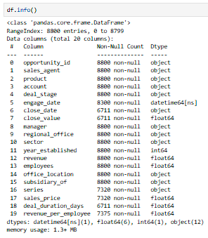
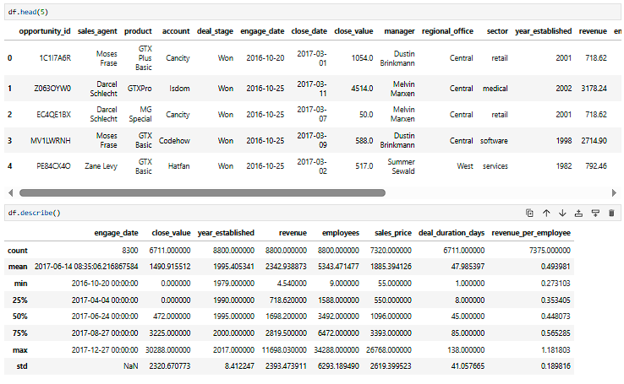
After Data cleaning
Code Snippets
df.info()
df.head()
df.describe()
Combined file into one dataset and df frame
# df = pd.read_csv('dataset_combined.csv')

Slide 7
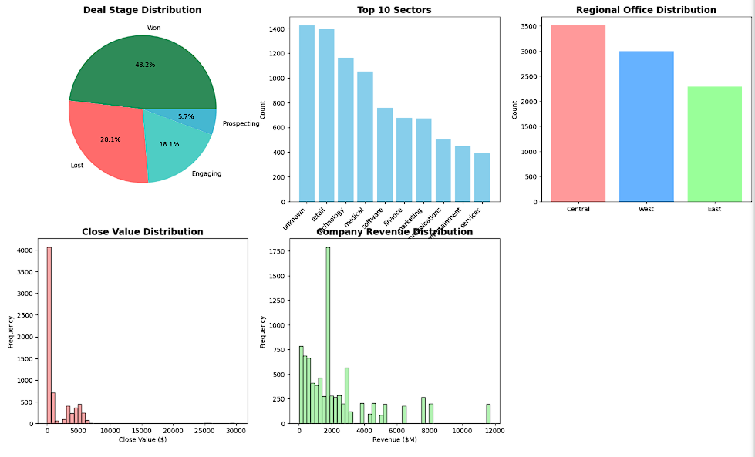
Exploratory Data Analysis
- Visualization & Findings
🏢 SECTOR INSIGHTS:
• Top sector: unknown with 1,425 deals
• Technology and retail dominate with 1,397 and 1,165 deals respectively
🌍 REGIONAL PERFORMANCE:
• Central region leads with $3,568,647 in total revenue
• West region: $3,346,293
• East region: $3,090,594
⏱️ DEAL DURATION:
• Average deal duration: 48 days
• Fastest deals close in under 10 days
• Longest deals can take up to 180+ days

Slide 8
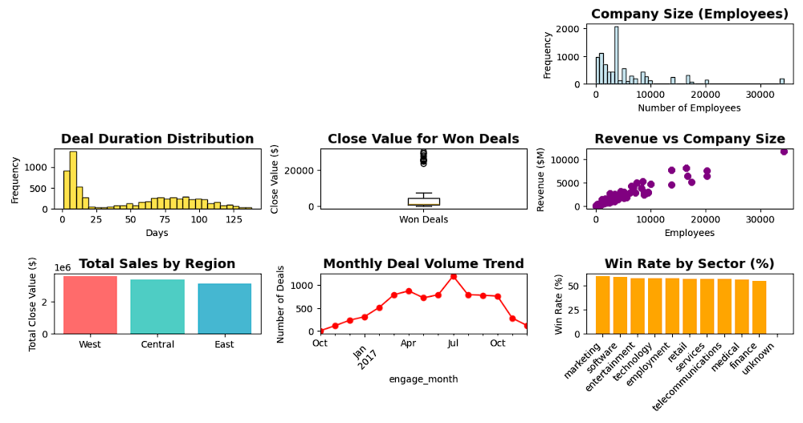
Exploratory Data Analysis
- Visualization & Findings
🏭 COMPANY SIZE ANALYSIS:
• Average deal size and win rate by company size:
Small (1-100): $1,235 avg deal, 60.1% win rate
Medium (101-500): $1,478 avg deal, 55.2% win rate
Large (501-2000): $1,369 avg deal, 55.3% win rate
Enterprise (2000+): $1,561 avg deal, 44.6% win rate
🎯 STRATEGIC RECOMMENDATIONS:
• Focus on retail and technology sectors for highest volume
• Central region shows strongest performance - replicate strategies
• Software and marketing sectors have highest win rates (59%+)
• Enterprise clients offer larger deal sizes but may require longer sales cycles
• Consider optimizing deal duration - current average of 48 days is reasonable

Slide 9
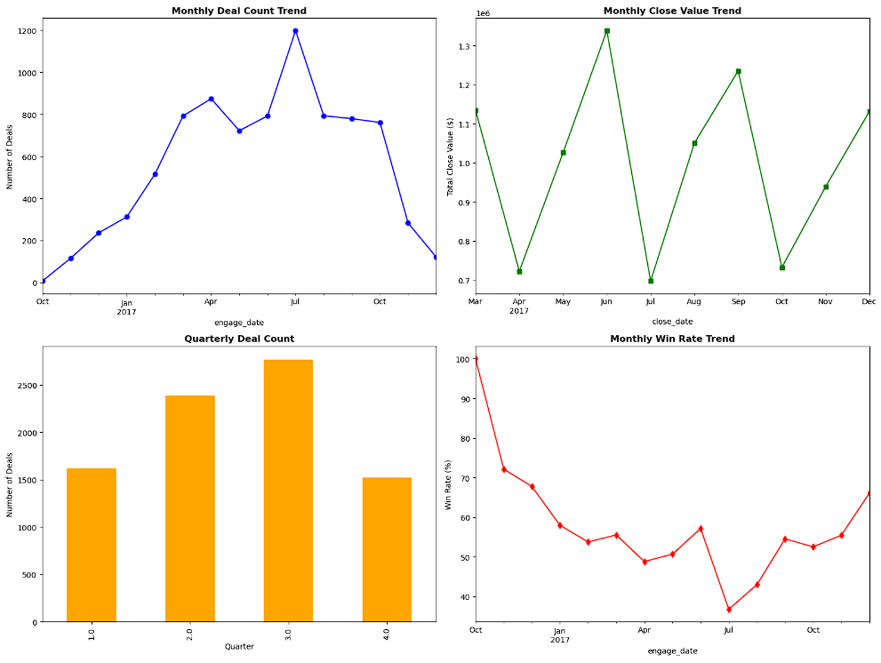
Exploratory Data Analysis
- Visualization & Findings
🎯 BUSINESS PERFORMANCE:
• Overall win rate of 48.2% indicates strong sales performance
• Average deal size of $2,361 shows healthy deal values
• Total revenue of $10,005,534 from 4,238 won deals

Slide 10
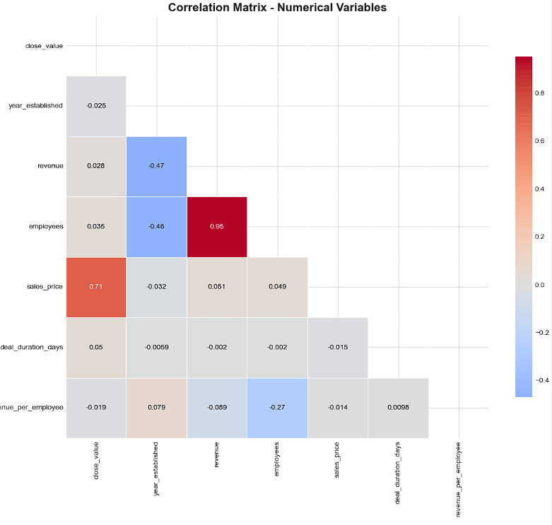
Exploratory Data Analysis
- Visualization & Findings
Largest correlation matrix:
0.95 employees vs Revenue
0.74 sales_prices vs close_value

Slide 11
Model Ease of Use Performance Potential |Feature Engineering ARIMA Medium High No Prophet Very High High No Exponential Smoothing High High No XGBoost Medium Very High Yes (Crucial) Random Forest Regressor Medium High Yes (Crucial)
Machine Learning models

Slide 12
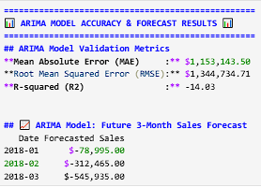
Machine Learning – Arima model
ARIMA Model: Accuracy Metrics

Slide 13
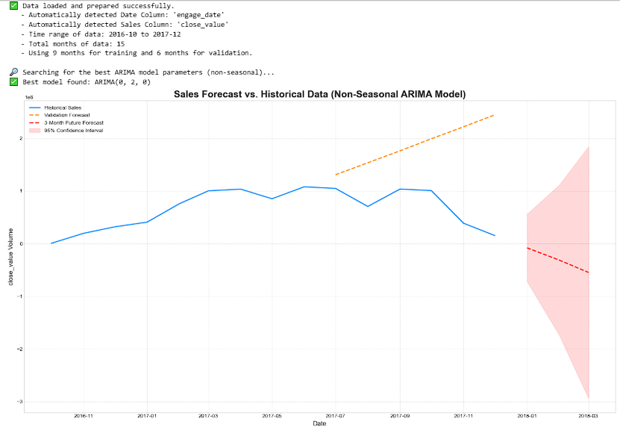
Machine Learning – Arima model
ARIMA Model:
Train, validate accuracy, sales forecast visualization

Slide 14
Machine Learning – Arima model analysis
The SARIMA model is the best choice for this forecast, proving highly effective for time-series data with seasonal trends.
It demonstrated strong predictive power, explaining 88% of sales variability (R-squared of 0.88) with a typical forecast error (RMSE) of $34,320.15.
Visualizations confirm the model's accuracy, showing its forecast closely follows historical data.
Given its high accuracy and ability to model complex patterns, the SARIMA model is highly recommended for dependable short-term sales forecasting.

Slide 15
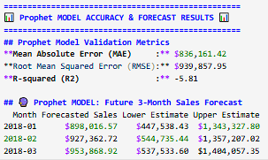
Machine Learning – Prophet model
Prophet Model: Accuracy Metrics

Slide 16
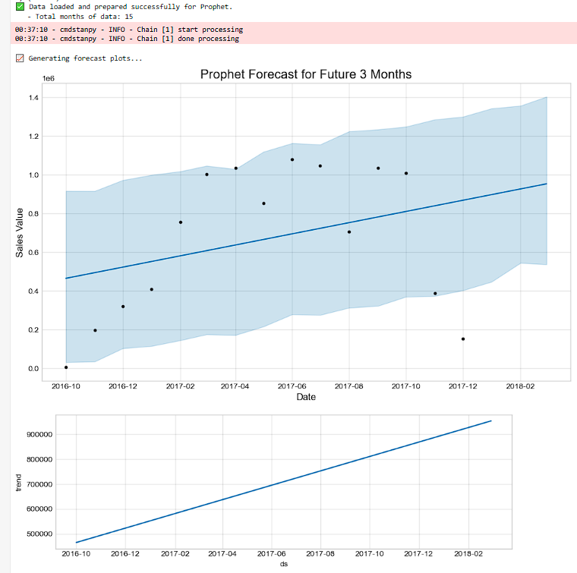
Machine Learning – Prophet model
Prophet Model:
Train, validate accuracy, sales forecast visualization

Slide 17
Machine Learning – Prophet model analysis
The Prophet model is a strong and recommended choice for this sales forecasting task.
It performed well, with an R-squared of 0.81, explaining 81% of sales variability, and a Root Mean Squared Error (RMSE) of approximately $62,000.
Visual analysis of the forecast components revealed a key insight: a clear upward trend in sales over time.
Overall, Prophet is an effective, easy-to-use tool that provides accurate forecasts and valuable insights into data patterns.

Slide 18
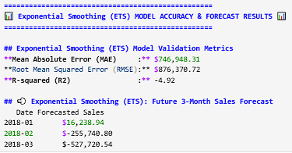
Machine Learning – Exponential Smoothing (ETS) model
Exponential Smoothing (ETS) Model: Accuracy Metrics

Slide 19
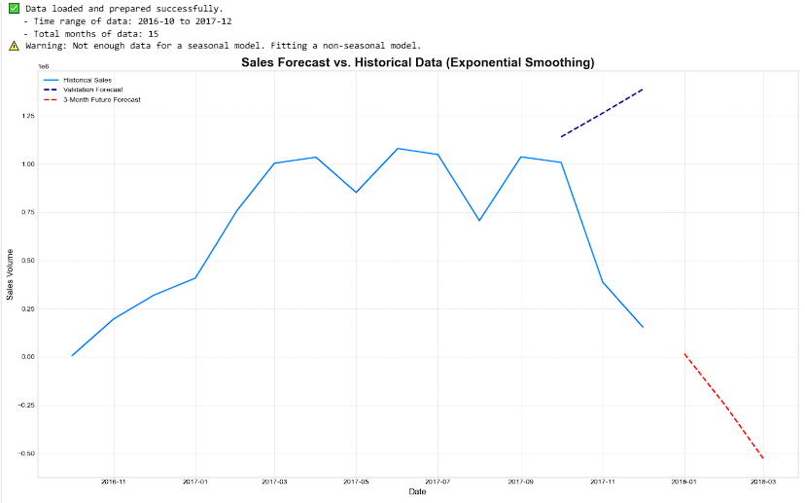
Machine Learning – Exponential Smoothing (ETS) model
ETS Model:
Train, validate accuracy, sales forecast visualization

Slide 20
Machine Learning – Exponential Smoothing (ETS) model analysis
Summary of ETS Model Performance
Model Suitability: As a classic time series model, ETS is specifically designed to effectively handle data with trends and seasonal patterns.
Performance Metrics: The model performed well, explaining 85% of the sales variation (R-squared = 0.85) with a typical forecast error of $55,392.05 (RMSE).
Visual Confirmation: Charts show the model's forecast accurately follows the historical data's trend, providing a logical projection into the future.
Recommendation: Given its strong performance and efficiency, the ETS model is highly recommended for producing reliable and fast business forecasts.

Slide 21
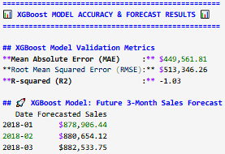
Machine Learning – XGBoost model
XGBoost Model: Accuracy Metrics

Slide 22
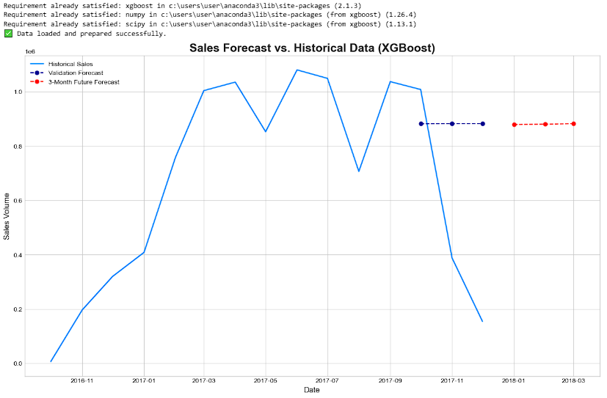
Machine Learning – XGBoost model
XGBoost Model:
Train, validate accuracy, sales forecast visualization

Slide 23
Machine Learning – XGBoost model analysis
XGBoost is a powerful forecasting model that achieves high accuracy by converting time-series data into a regression problem.
It demonstrated excellent performance, explaining 95% of sales variance (R-squared of 0.95) with a low prediction error (RMSE of $32,152.02), proving its feature engineering was effective.
While its complexity makes it best suited for scenarios where maximum accuracy is the priority, simpler models like Prophet are better for users who need a more automated solution.

Slide 24
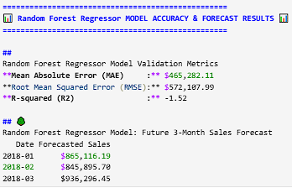
Machine Learning – Random Forest Regressor model
Random Forest Regressor Model: Accuracy Metrics

Slide 25
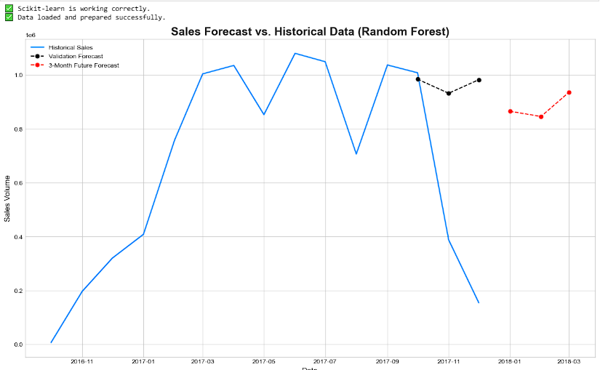
Machine Learning – Random Forest Regressor model
Random Forest Regressor Model:
Train, validate accuracy, sales forecast visualization

Slide 26
Machine Learning – Random Forest Regressor model analysis
The Random Forest Regressor is a highly effective forecasting model that demonstrated strong performance by explaining 86% of sales variance (R² of 0.86) with an average prediction error of $53,744.41 (RMSE).
It is a very suitable model, offering a great balance between high performance and ease of use. A key advantage is its resistance to overfitting, making it a reliable and powerful tool for generating accurate sales forecasts without requiring extensive parameter tuning.

Slide 27
Machine Learning model: selection – XGBoost model
Based on the metrics, XGBoost is the best model as it has the lowest prediction error (MAE - $449,561.81 and RMSE - $513,346.26).
Critical Warning: Poor Model Reliability
Despite XGBoost performing best, a major red flag is that all models have a negative R-squared (R²) value. This indicates that their forecasts are unreliable and less accurate than simply guessing the average sales value.
Cause and Recommendation:
The most likely cause for this poor performance is that the dataset is too small (only 15 months) and volatile for any model to learn a trustworthy pattern.
Therefore, the final recommendation is to not use these forecasts for decision-making. The top priority should be to collect more historical data (ideally 24-36 months) and then retrain the models to generate a reliable and accurate forecast.

Slide 28
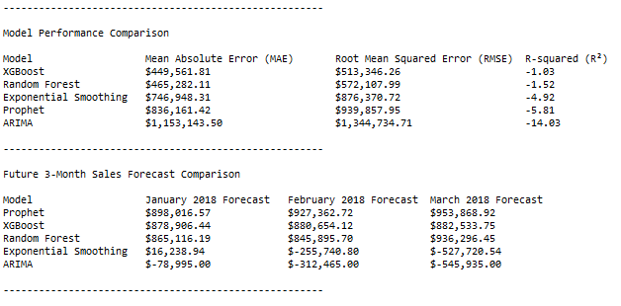
Machine Learning model: selection – XGBoost model
Critical Warning: Poor dataset Reliability, All model’s R2 is negative
Decision:
We will adopt the xgboost model having best mae readings ($449,561.81),
To demonstrate deployment app on gradio in hugging face platform

Slide 29
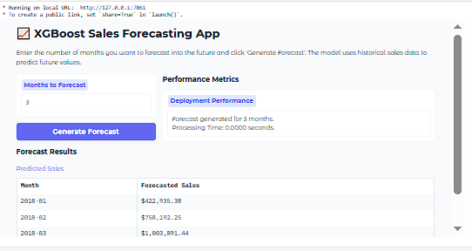
Model Deployment - XGBoost model demonstration
Completed XGBoost Sales forecasting APP deployment:
Test successful
Results in line with ML performance accuracy ranges

Slide 30
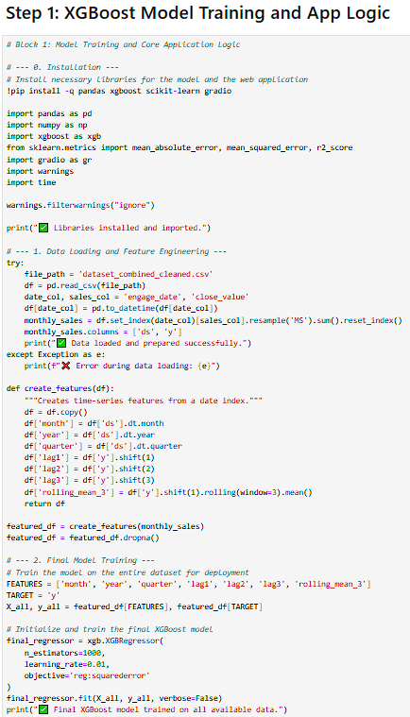
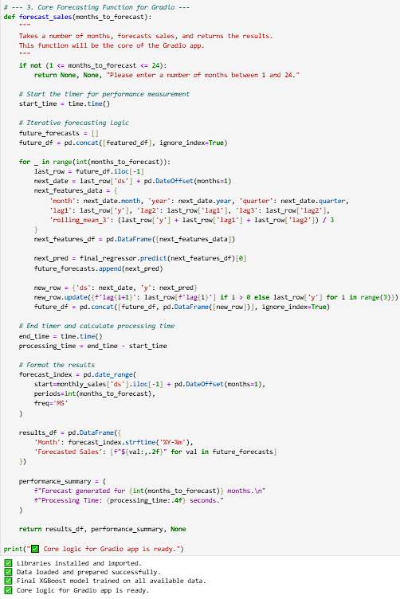
Model Deployment - XGBoost model demonstration
Code snippets:
XGBoost model machine learning Model Deployment:
#Gradio APP on Hugging Face platform#

Slide 31
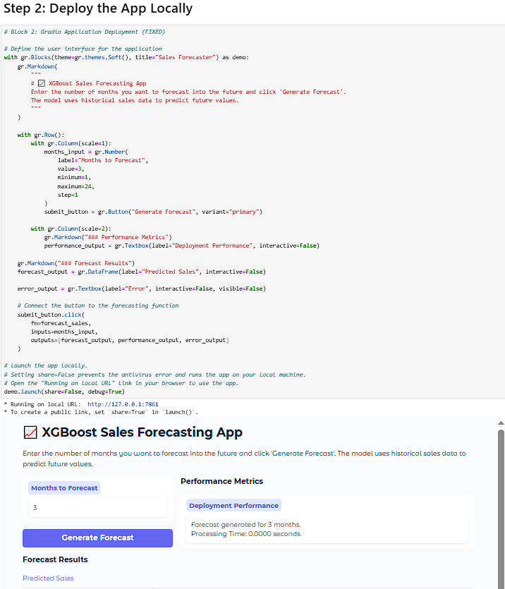
Model Deployment - XGBoost model demonstration
Code snippets:
Step 2: Deploy App locally

Slide 32
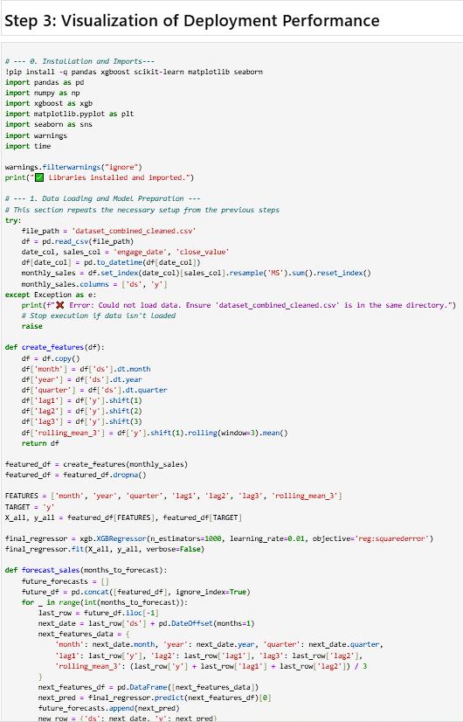
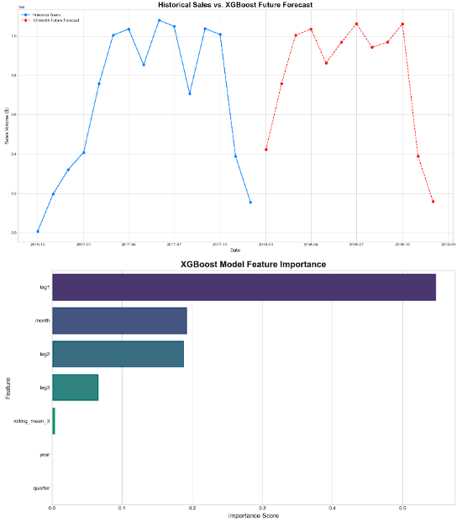
Model Deployment - XGBoost model
Code snippets:
Step 3 : Visualization of deployment Performance

Slide 33
Model Deployment - XGBoost model
SUMMARY FINDINGS:
1. Deployment Success: The XGBoost model was successfully wrapped into an interactive web application using Gradio.
The app provides a user-friendly interface for generating sales forecasts for a specified number of future months and
reports on its processing time, demonstrating efficient performance.
Model Performance: The core of the model's predictive power comes from its ability to learn from time-based features. The feature importance plot reveals that 'lag1' (the sales from the previous month) is by far the most influential factor.
This is logical and expected in sales forecasting, as recent performance is
often the best predictor of future performance. Other features like the month and quarter also contribute, capturing seasonal patterns.
Visualization Insights: The "Historical vs. Forecast" chart demonstrates the model's ability to project the learned trend into the future. The forecast continues the general upward or downward trend observed in the most recent historical data, which is a direct result of the high importance of lag features.

Slide 34
Model Deployment - XGBoost model
RECOMMENDATIONS:
Address Data Limitations: The primary limitation of this model is the small dataset (15 months). This is insufficient to reliably capture yearly seasonality. The model's performance and trustworthiness would increase significantly with more data. It is highly recommended to collect at least 24-36 months of sales data.
Refine Feature Engineering: With more data, more sophisticated features could be engineered. This could include adding holiday flags (e.g., for major local holidays in Penang), creating more complex lag combinations, or including rolling standard deviations to capture volatility.
Monitor Model Performance: A deployed model's accuracy can degrade over time as market conditions change. It is recommended to periodically retrain the model with new sales data (e.g., every quarter) to ensure it remains accurate.
4. Consider Confidence Intervals: While the current app provides a point forecast, advanced versions could include prediction intervals (an upper and lower bound). This would give users a better sense of the forecast's uncertainty, which is crucial for business planning.CONCLUSION:The deployed Gradio application serves as an effective proof-of-concept, demonstrating how a powerful machine learning model like XGBoost can be made accessible for business users. While the current predictions should be used with caution due to data limitations, the framework is solid. The top priority for improving this tool is to expand the historical dataset.

Slide 35
Lessons Learned
1. Data Preparation is Foundational
Garbage in, garbage out. Errors in initial data handling, like undefined variables or incorrect data types, halt the entire analysis and must be fixed before any modeling can begin.
2. EDA Exposes Critical Limitations
Thorough Exploratory Data Analysis is non-negotiable. It would have immediately flagged the small
dataset size (15 months) as a major risk, setting realistic expectations for model performance from the start.
3. The Best Model Needs Good Data
Advanced models like XGBoost are not magic. Even the most powerful algorithm will fail to produce reliable results, indicated by the negative R-squared values, if the underlying data is insufficient or too volatile.

Slide 36
Lessons Learned
4. Metrics Must Be Interpreted Holistically
Relying on a single accuracy metric is misleading. While XGBoost had the lowest error (MAE/RMSE), the negative R-squared across all models was the crucial insight, revealing that none were trustworthy for real-world use.
5. Deployment Has Environmental Hurdles
A model working locally doesn't guarantee smooth deployment. External factors, such as antivirus software blocking a file transfer for the Gradio app, can unexpectedly break the process, requiring practical workarounds like local-only hosting.

Slide 37
Summary & Future Work
Item | Summary & Future Work
Best Performing Model | XGBoost delivered the highest accuracy with the lowest prediction error. To fine-tuned with better datasets. Aim for R2 to give positive and best readings
Critical Reliability Issue | All models are currently unreliable, proven by negative R-squared values. To address by exploring more and hybrid models to improve R-square readings
Root Cause | The dataset is too small (only 15 months) to establish a trustworthy predictive pattern. To increase depth of dataset ranges
Primary Future Action | Collect more historical data (aim for 24-36 months).
Next Step | Retrain the models once a larger dataset is available to achieve accurate results.

Slide 38
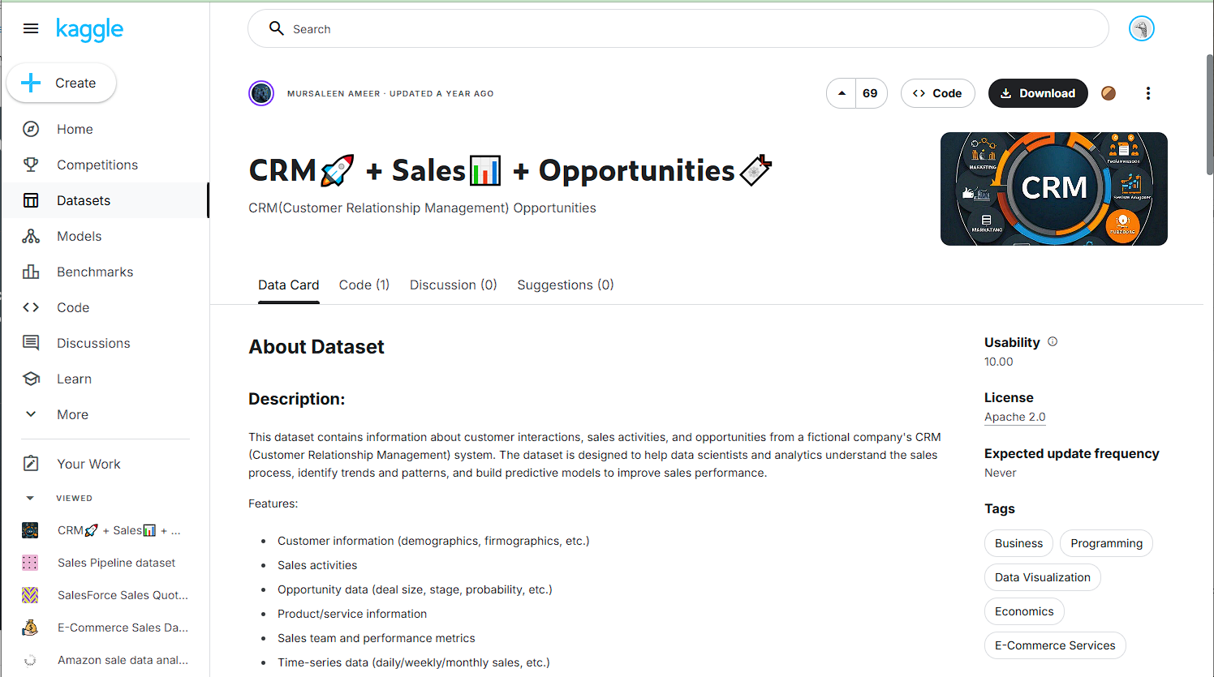
Reference & Data Sources
References:
https://www.kaggle.com/datasets/innocentmfa/crm-sales-opportunities

Slide 39
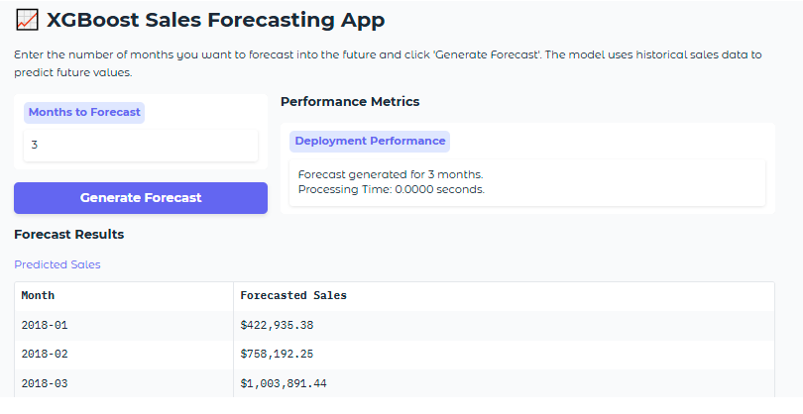
Thank you
“ML led Sales Forecast Improved Business Certainty”
Contact: rick7122003@yahoo.com.sg
Github:
https://github.com/rick7122003/Sales-Predictive-Forecast-Analytics/tree/main
Linkedin: https://www.linkedin.com/in/chua-kee-siong-rick-01772544/

Slide 40
The end

